Slide 1


A Project on
“MatriCare AI - AI based Prediction of
Labour related Complications”
Presented By
1. Varsha Devdas - 73
2. Sakshi Bhumkar - 64
3. Aditya Kamble - 49
4. Md Zaid Sutar - 38
Class : B. Tech. Sem-I
Under the guidance of
Prof G N Chanderki
Department of Artificial Intelligence & Data Science
N.K. Orchid College of Engineering & Technology, Solapur.
2025-2026

Slide 2
Contents
Abstract
Literature Review/Related Work
Research /Application Gap
Objective of Proposed Project
5. Proposed Methodology
6. Expected Outcome
7. References

Slide 3
Abstract
MetriCare AI is an AI-powered healthcare system to predict and prevent pregnancy-related complications. It has two main parts:
Labour Care Module – monitors the mother during 36–40 hours of labour using vital signs and fetal data to give early warnings for risks such as heavy bleeding, seizures, infection, or fetal distress.
Pregnancy Care Module – supports mothers through the full 9 months with simple nutrition tips, exercise suggestions, and early risk prediction for issues like diabetes and high blood pressure.
The goal is to provide timely support for doctors and continuous guidance for mothers, ensuring safer deliveries and healthier pregnancies.

Slide 4
Literature Review/Related Work
Researchers have explored AI in pregnancy and labour risk prediction. Sharma et al. used deep learning for maternal mortality prediction [1], while Huang et al. applied ML to fetal heart rate data for detecting distress [2]. Reviews by Al-Dalou et al. [3] and Das et al. [4] highlight the use of ML in pregnancy but also point out gaps in continuous intrapartum monitoring. Suresh et al. introduced interpretable models for maternal complications [5], and Zhang et al. predicted postpartum hemorrhage using ML [6]. Westgate et al. worked on real-time fetal health prediction [7], and Nunes et al. improved intrapartum risk scoring with gradient boosting [8].

Slide 5
Research / Application Gap
Most existing systems focus only on mortality statistics rather than real-time complication prediction.
Limited use of AI on continuous labour monitoring data (36–40 hrs).
Very few solutions combine both pregnancy care (9 months) and labour care in one system.
Lack of personalized guidance (nutrition, exercise, lifestyle) for expecting mothers.
Minimal deployment of AI-powered early warning systems in rural or resource-limited healthcare settings.

Slide 6
Objective of Proposed Project
To design an AI-based system for predicting pregnancy and delivery-related complications.
To develop a Labour Care Module that provides real-time alerts for risks like hemorrhage, eclampsia, sepsis, and fetal distress.
To build a Pregnancy Care Module that offers nutrition, exercise suggestions, and early risk prediction throughout 9 months.
To assist healthcare professionals with timely decision-making during labour.
To empower mothers with continuous support and self-care guidance during pregnancy.

Slide 7
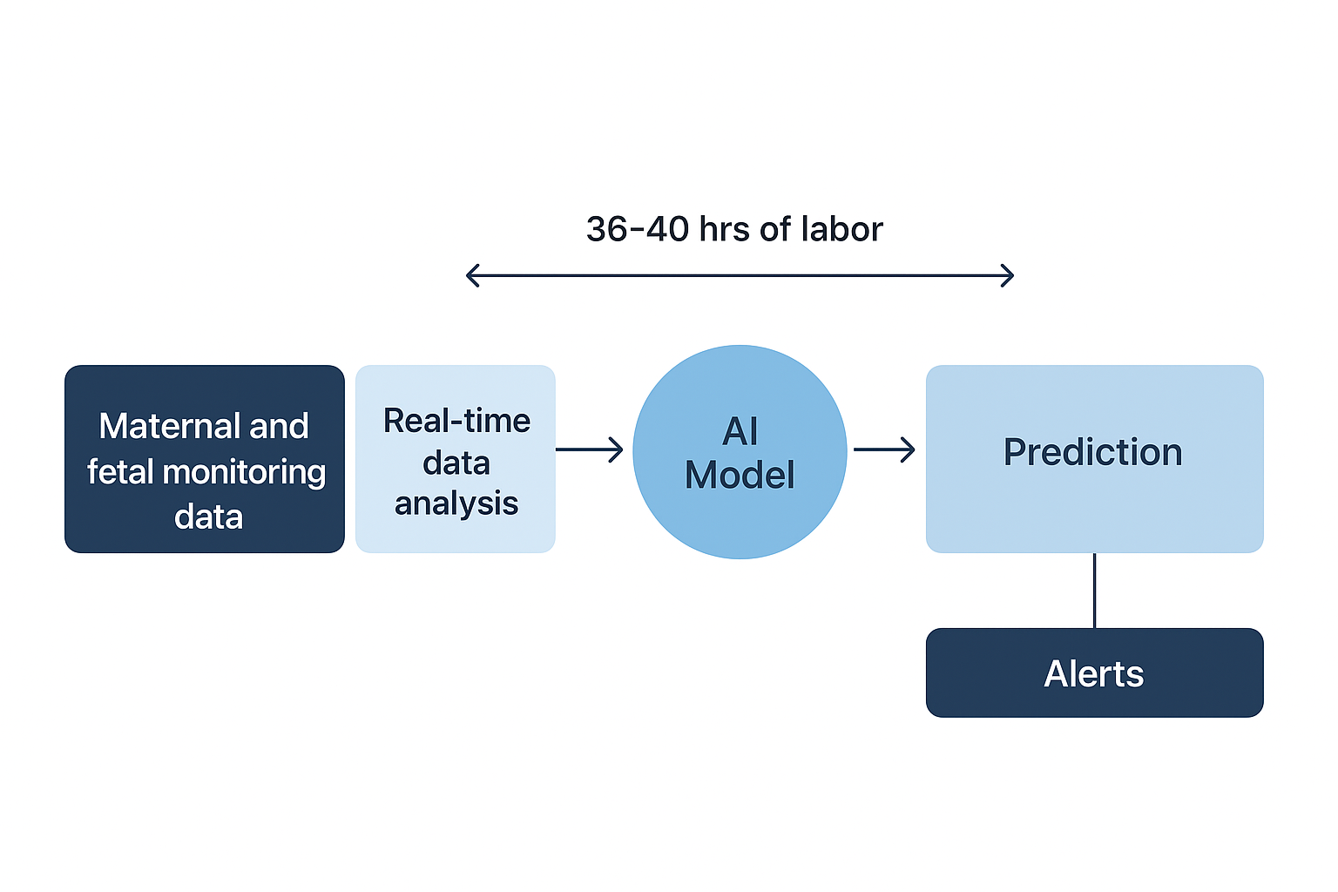
Proposed Methodology

Slide 8
Expected Outcome
An AI-powered system (MetriCare AI) for predicting pregnancy and labour-related complications.
Labour Care Module that provides real-time early warnings during 36–40 hrs of delivery.
Pregnancy Care Module that guides mothers with nutrition, exercise, and risk alerts across 9 months.
Improved safety for mothers and babies through timely interventions.
A step toward smart healthcare solutions for maternal well-being in both urban and rural settings.

Slide 9
References
[1] R. Sharma et al., "Deep Learning for Predicting Maternal Mortality," BMC Pregnancy and Childbirth, 2023.
[2] Y. Huang et al., "Machine Learning Prediction of Non-Reassuring Fetal Heart Rate Patterns in Labor," Scientific Reports, 2025.
[3] A. Al-Dalou et al., "Using Machine Learning to Predict Complications in Pregnancy: A Systematic Review," Frontiers in Bioengineering and Biotechnology, vol. 9, p. 780389, 2021.
[4] S. Das et al., "Machine Learning in Obstetrics: Prediction of Diseases and Risks," Lancet Digital Health, vol. 5, no. 2, pp. e100–e110, 2023.
[5] H. Suresh et al., "Interpretable Machine Learning for Pregnancy Complications using Explainable Boosting Machines," arXiv preprint arXiv:2310.10203, 2023.
[6] L. Zhang et al., "Machine Learning for Postpartum Hemorrhage Prediction in Labor and Delivery," JMIR Bioinformatics and Biotech., vol. 5, no. 1, p. e52059, 2024.
[7] J. Westgate et al., "Prediction of Fetal Cardiovascular Decompensation Using Machine Learning Models on FHR Data," arXiv preprint arXiv:1911.01304, 2019.
[8] R. Nunes et al., "Intrapartum Risk Scoring with Gradient Boosting Improves Prediction of Labor Outcomes," PLoS One, vol. 17, no. 12, p. e0278050, 2022.

Slide 10

THANK YOU

